Slide 1
Bus Tracking System
Android Application

Slide 2
About us
Group Name: Android Developers
Group Members:
Anurag Chitnis
Satyanarayana Chivukula
Nitesh Kumar Sharma
Gill Wasserman

Slide 3
Overview
Project Description, Motivation
Major functions, Development Environment
Team member responsibilities
Project directory structure
Project schedule – PERT and Gantt chart, MOM
Risk Management

Slide 4
Project Description
Motivation – Current UNT bus system, problems
Major Functions
tracking of buses and e-ride using GPS
Rout information and schedule on google map
Development Environment
Android Studio
GitHub

Slide 5
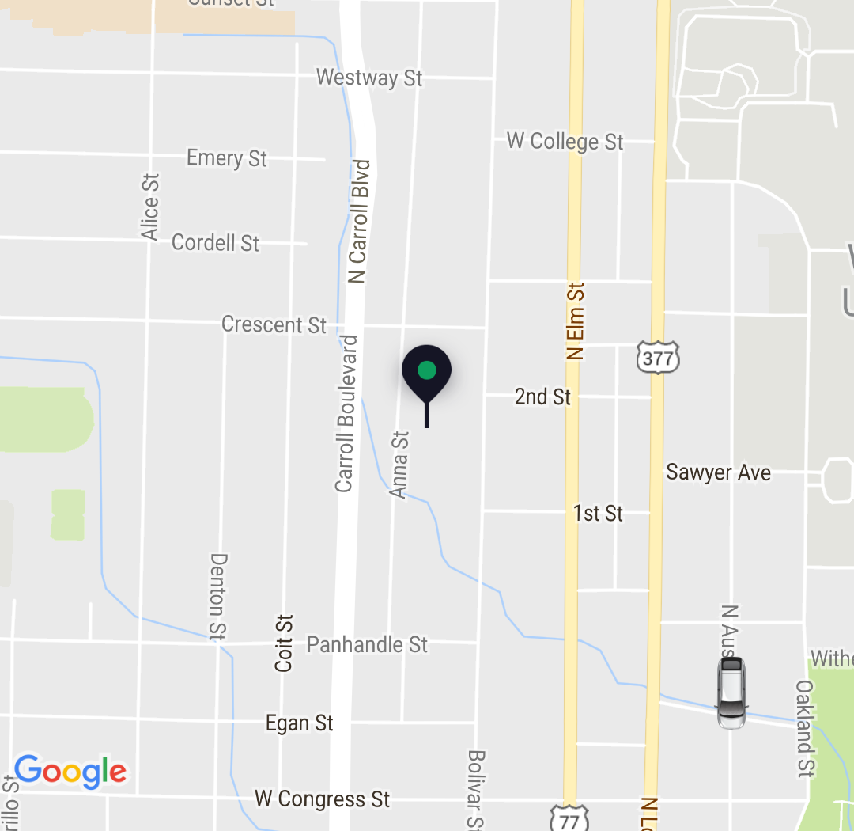
Sample user interface
Showing the bus and user location on the map

Slide 6
Project schedule
PERT Chart
Program Evaluation and Review Technique
Enable the manager to monitor and control project progress and detect deviations
Gantt Chart
Tracking Technique
helps understand which activities can be performed concurrently

Slide 7
PERT CHART

Slide 8
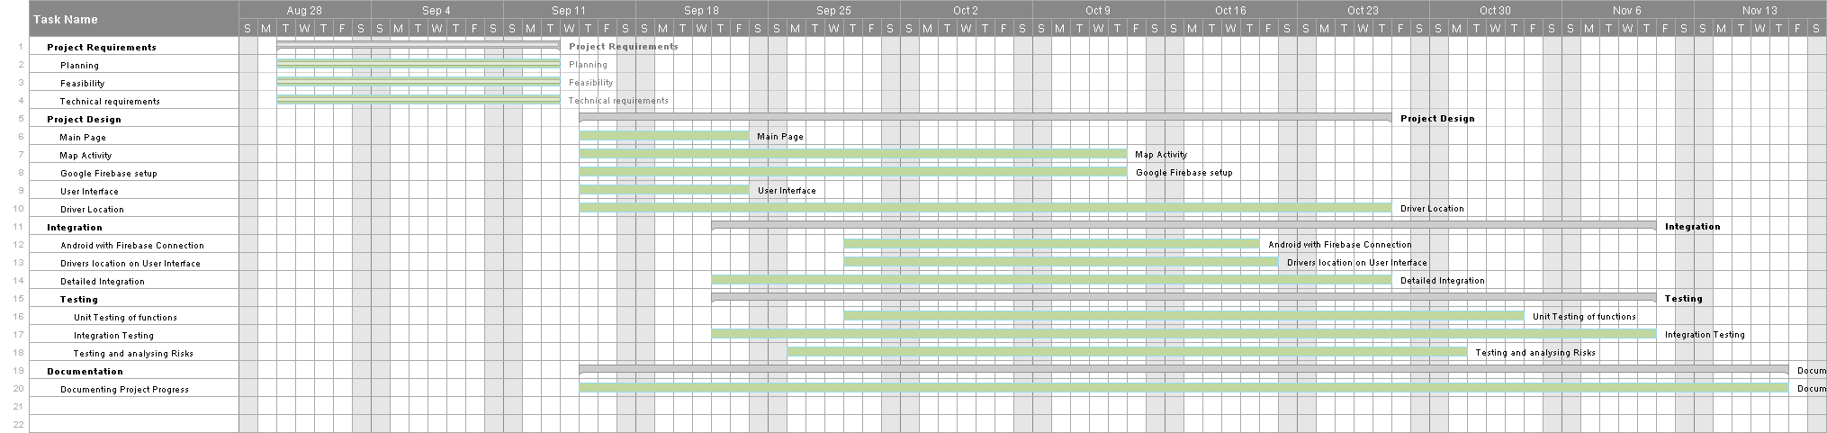
Gantt Chart

Slide 9
Minutes of meeting
Every Tuesday and Thursdays from 10:40 AM to 11:20 AM
All the four team members
Updated in GitHub on every MOM by every team member
Things Discussed
Project Requirements, feasibility, scope and technical requirements
Responsibilities, contribution and workload for each team member
Risk Management and contingency plans

